Slide 1
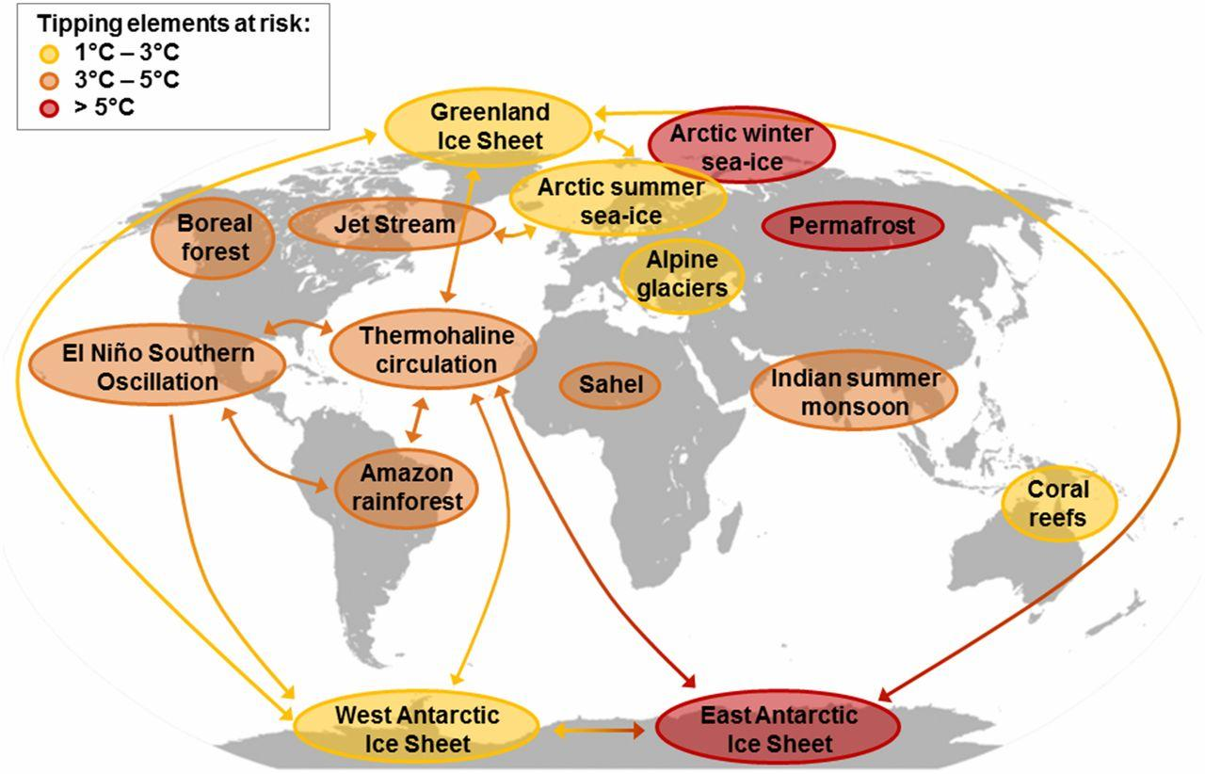
Back in Week 4, we considered Lenton’s picture of “Tipping Elements” and “Tipping Points”
A tipping element is a feedback mechanism (and we probably don’t know about all of them).
A tipping point is the temperature at which that mechanism will kick in, so we should keep warming below those values.

Slide 2
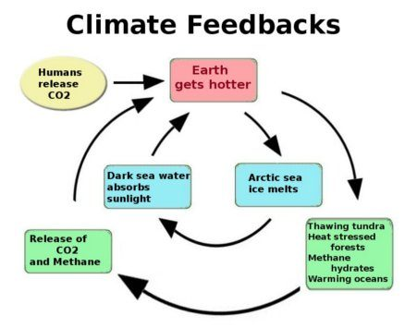
Tipping points encompass the idea of irreversibility (at least, on a human time scale)
Crossing a tipping point: when the initial forcing is no longer needed to keep the cycle going

Slide 3
Reframing Tipping Elements as Sacrifice Zones
A sacrifice zone is a region of the planet that we are willing to tolerate being destroyed by continued release of carbon into the climate system.
A sacrifice zone tipping point is the temperature at which we can expect the zone to be irreversibly sacrificed.
This list is undoubtedly incomplete, however, because we don’t understand the climate system well enough yet.

Slide 4
Small group discussion
How does this reframing change the way we understand climate risk, responsibility, and decision‑making?
In your response, consider at least one of the following angles:
Ethics: Who decides which regions become “sacrificed,” and who bears the consequences?
Science: Does the sacrifice‑zone framing help or hinder public understanding of climate feedbacks and uncertainty?
Policy: How might climate negotiations or mitigation priorities shift if we explicitly acknowledged sacrifice zones?
Equity: Which communities or ecosystems are most likely to be framed as “acceptable losses,” and why?

